Slide 1
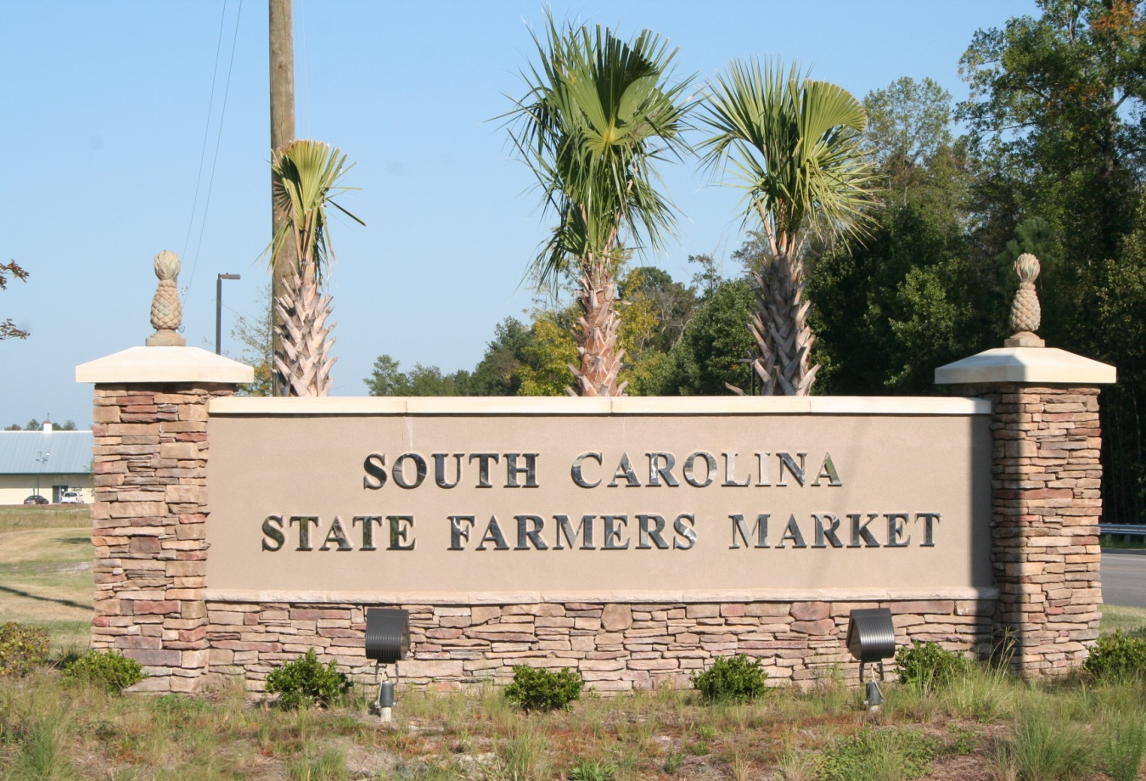
State Farmers Market Initiative 2013
Proposal as a result of the appraisal funded and directed by the General Assembly

Slide 2
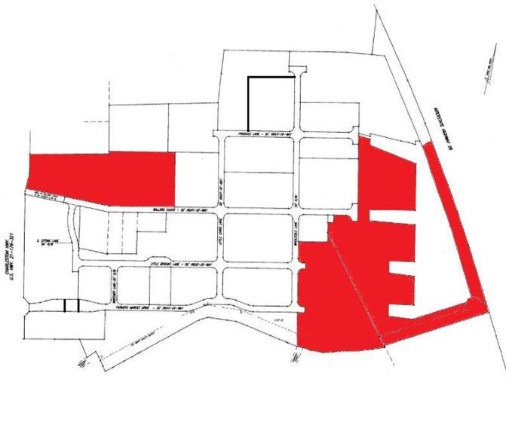
State Farmers Market Initiative 2013
Current
State Owned
39.4 of 137 acres

Slide 3
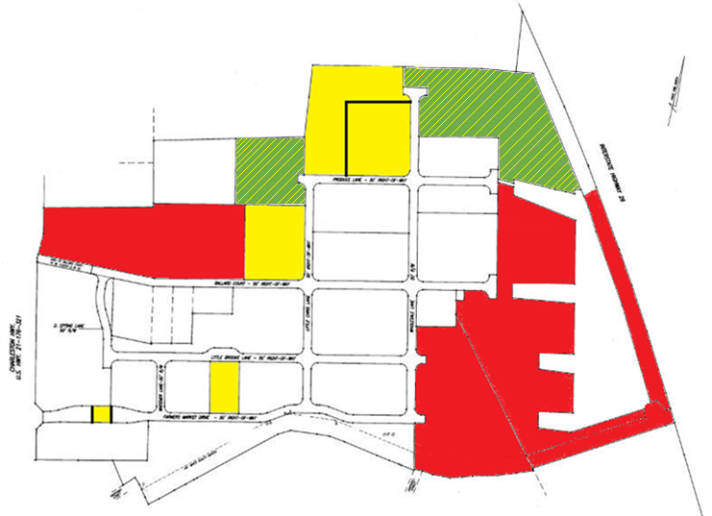
State Farmers Market Initiative 2013
Current
State Owned
Proposed Purchases
Improved
Land
69.87 of 137 acres

Slide 4
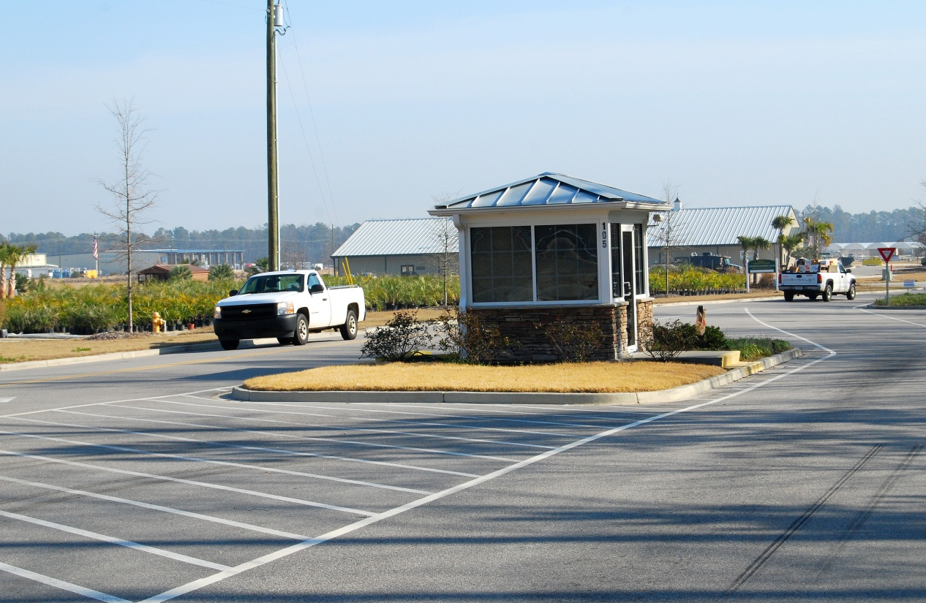
State Farmers Market
Front Gate Operation

Slide 5
Wholesale Buildings and Sheds on Lot 25

Slide 6
Corbett Building – Including Restaurant

Slide 7
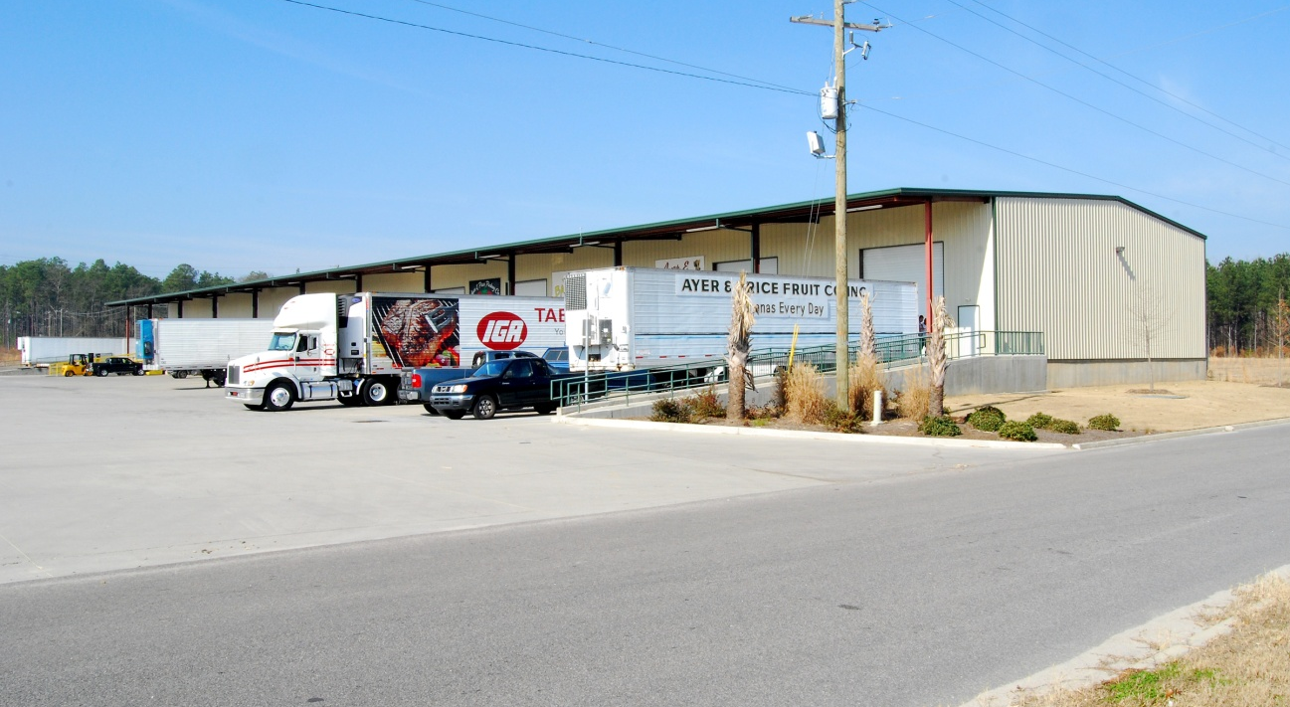
FM Properties LLC

Slide 8
Proposed Purchases State Appraisal Values
Asset
Front Gate 990,000
Wholesale Sheds 3,450,000
Wholesaler Bldg. 2,635,000
Corbett Bldg. 2,560,000
Corbett Bldg. Restaurant 255,000
FM Properties. LLC 3,630,000
Land 900,000
___________________________________________
Total $14,420,000

Slide 9
Financial Impact of Acquisitions
Projected Cash Flow From Acquisitions (gross $)
Front Gate Income 145,000
Additional Farmers Shed Stall Rental (24/7 gate) 85,000
Lot 25 Wholesale Sheds Rent 430,000
Lot 25 Wholesale Vendor Bldg. Leases 230,000
Corbett Bldg. Lease Payment Terminated 195,000
FM Properties LLC Wholesale Vendor Bldg. Leases 320,000
___________________________________________________________
Total $1,405,000

Slide 10
Additional Operating Costs
Personnel 235,000
Utilities 30,000
Security 45,000
Waste Handling 25,000
Equipment & Bldg. Repair & Maintenance 30,200
Insurance 11,600
Gas & Diesel 6,200
Other Increases 6,950
_______________________________________________________
Total $389,950

Slide 11
Post-Acquisitions Market Operations Projection
Net Financial Impact From Acquisitions
$1,015,050
Current Negative Cash Flow
($303,400)
_____________________________________________________________
Projected Cash Flow Post-Acquisitions
$711,650

Slide 12
Return on Investment
Net Financial Impact From Acquisitions
$1,015,050
Cost of Acquisitions
$14,405,000
_____________________________________________________________
Return on Investment
7.05%

Slide 13
Proposed Acquisitions
Previous Proposal (FYI)
$16,300,000
Current Proposed Acquisitions
$14,405,000

